Slide 1
Third Part/Chapter of the Autonomic Nervous System (ANS) Pharmacology
Introductory Pharmacology PHAR2001
Dr. Ken Wojcikowski

Slide 2
Objectives
Describe the actions interactions and side effects of the following adrenergic antagonists:
  Phentolamine and labetalol (non-selective antagonist)
  Prazosin and doxazosin (an alpha 1 selective antagonist)
  Metoprolol and atenolol (a beta 1 selective adrenergic antagonist)
  These medications will be taken again at a later time. It is most important right now to understand why the actions and side effects occur.

Slide 3
Autonomic Nervous System Pharmacology
Sympatholytics (drugs that block the SNS)
Lesson 1:
Understanding drugs that block the SNS
Introductory Pharmacology PHAR2001
Dr Ken Wojcikowski

Slide 4
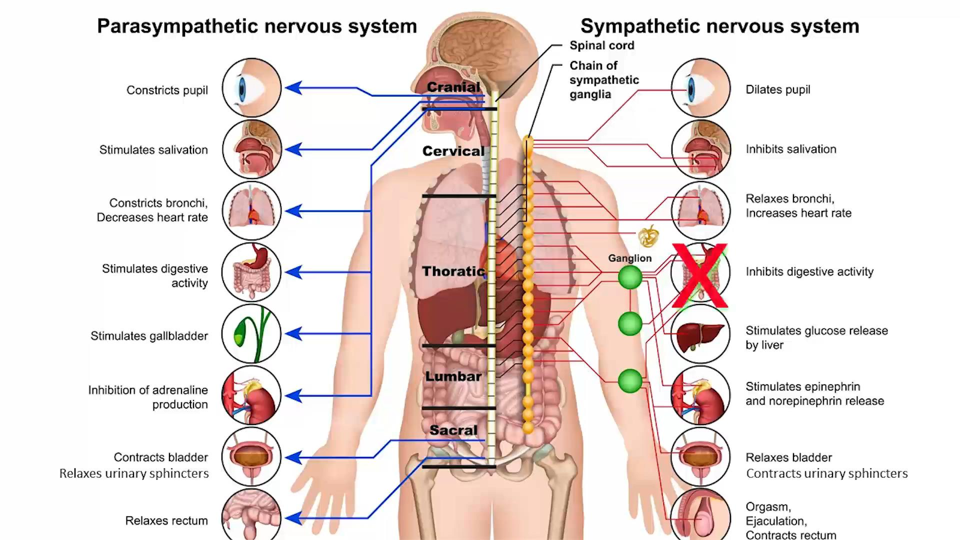
Sympatholytic agents allow the parasympathetic nervous system dominate

Slide 5
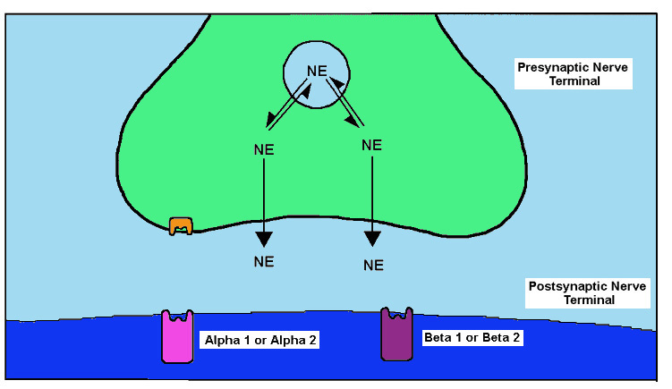
Sympatholytic drugs
Block adrenoreceptors on the surface of an effector or
Prevent transmission by adrenergic nerves
1. block
2.prevent

Slide 6
Autonomic Nervous System Pharmacology
Sympatholytics
Lesson 2:
Non-selective adrenergic blockers
Introductory Pharmacology PHAR2001
Dr Ken Wojcikowski

Slide 7
Non-selective sympatholytic drugs
Mostly used to treat hypertension
Labetalol (know this drug; used to treat pre-eclampsia)
Adverse effects
  Postural hypotension
  Blurred vision
  Bronchospasm (dyspnoea; contraindicated in asthma)
  Swollen ankles
  Nasal congestion

Slide 8
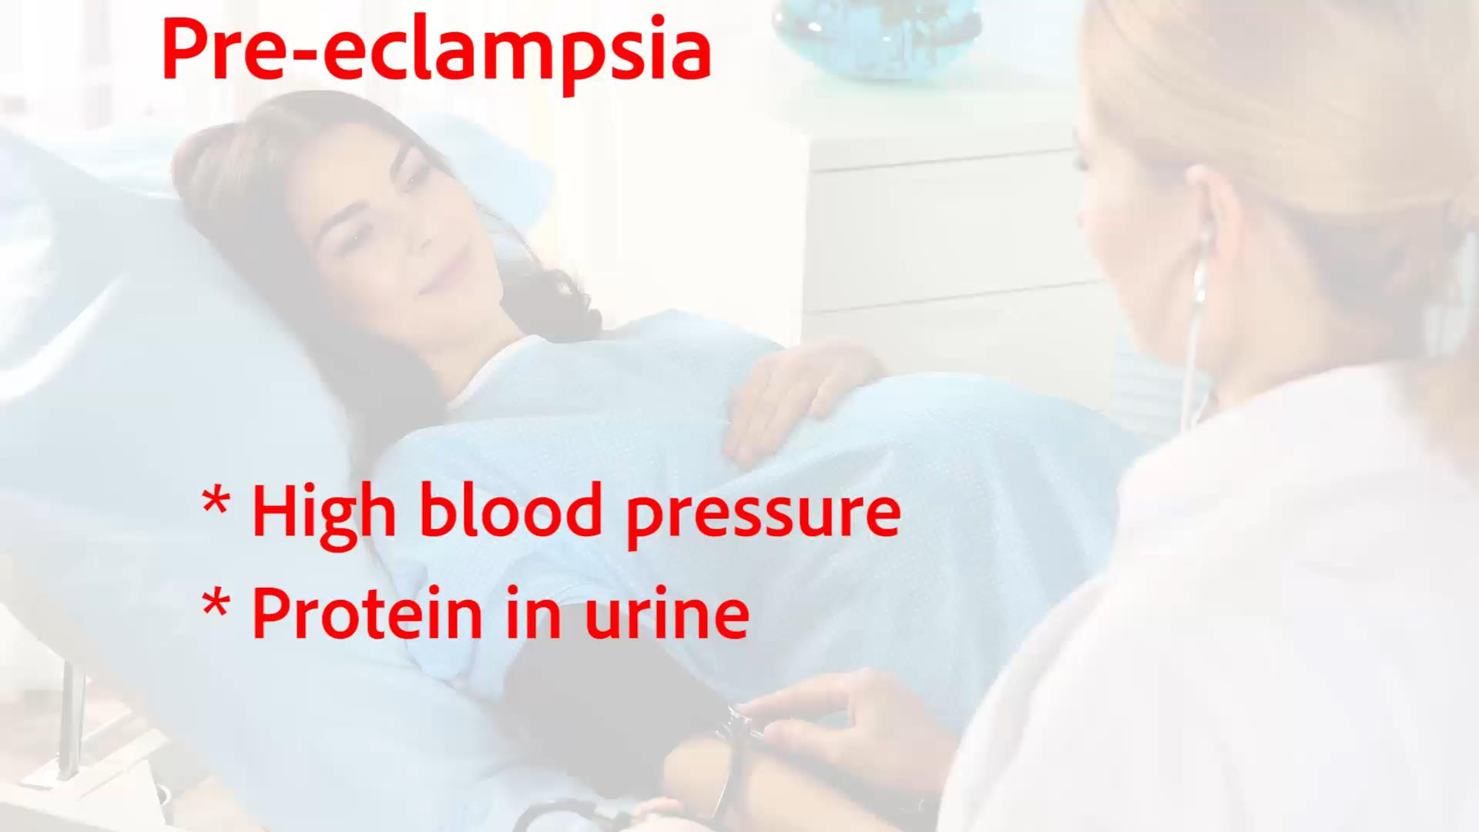
Pre-eclampsia can advance to life threatening eclampsia

Slide 9
Alpha antagonists
Recall the location of receptors:
  Blood vessels
  Smooth muscles of the GIT
  Radial muscles of the eye
  Sphincters of the bladder
If you block the adrenergic activity of these,
  Vasodilation = decreased blood pressure
  Increased GI motility and secretions
  Pupil constriction
  Increased micturition

Slide 10
Non-selective Alpha antagonists
Phentolamine (Regitine; know this drug)
Used to:
  Control hypertensive emergencies, cocaine overdose, and adrenaline overdose
  Locally to increase blood flow for instance in the location of an injection of adrenaline
Side effects:
  Nasal congestion
  Postural (orthostatic) hypotension

Slide 11
Autonomic Nervous System Pharmacology
Sympatholytics
Lesson 3:
Selective adrenergic blockers (Part 1: Alpha 1 blockers)
Introductory Pharmacology PHAR2001
Dr Ken Wojcikowski

Slide 12
Alpha 1 antagonists
Receptors in the blood vessels and prostate
Drugs end in ‘…osin’ alfuzosin, prazosin…
Treatment of
  Hypertension
  Benign prostatic hyperplasia
  May result in hypotension!!

Slide 13
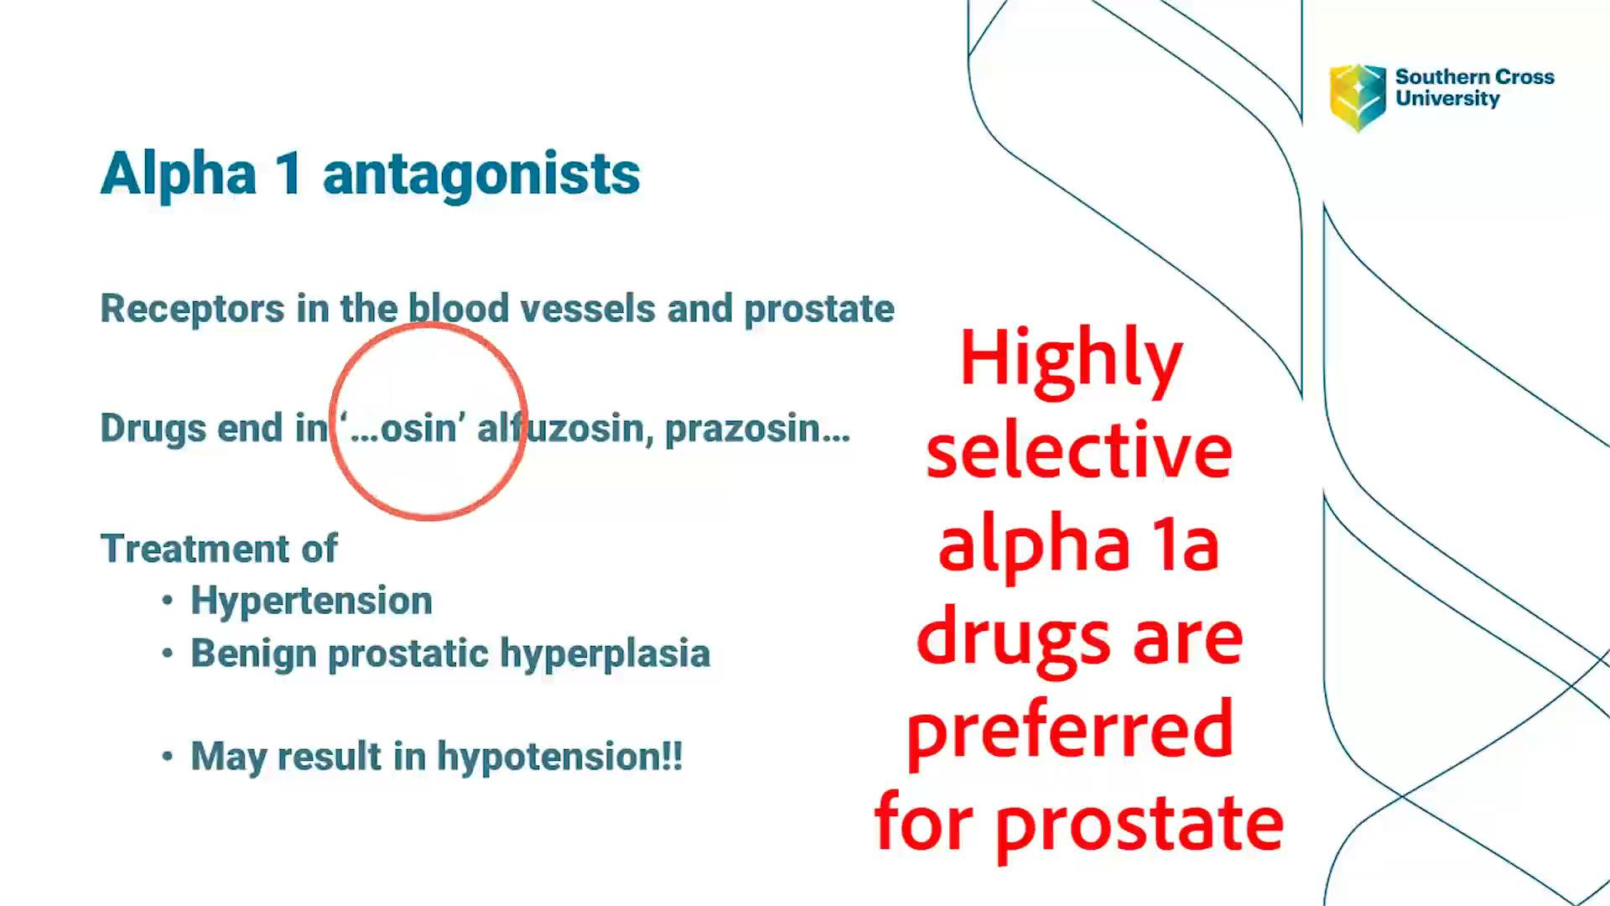

Slide 14
Autonomic Nervous System Pharmacology
Sympatholytics
Lesson 4:
Selective adrenergic blockers (Part 2: Beta blockers)
Introductory Pharmacology PHAR2001
Dr Ken Wojcikowski

Slide 15
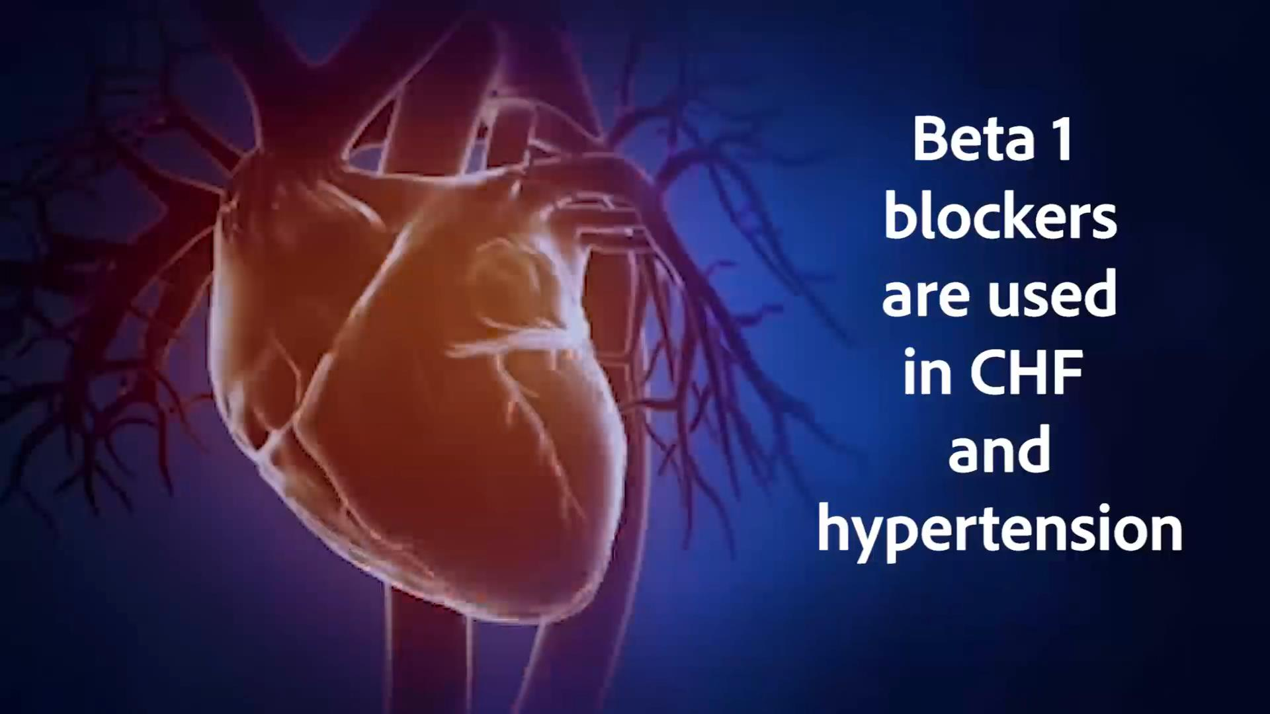
Beta blockers

Slide 16
Beta antagonists (…olol drugs)
Can be non-selective:
  Propranolol (know this drug; first of this class, but crosses blood brain barrier)
  Timolol (know this drug; treatment of choice in the patient with hypertension and angina)
  Acebutolol… (other examples)
Or selective for Beta 1 or Beta 2 receptors, but there are no clinical applications for Beta 2 antagonists
Selective Beta 1 antagonists were developed to reduce bronchospasm
  Contraindicated for those with asthma, COPD, allergies

Slide 17
Beta 1 antagonists
The blockage of the beta 1 receptors in the heart
  Decreased chronotropic effects
  Decreased inotropic effects
  Together, these have the effect of
    stabilising the rhythm and
    leading to decrease in arrhythmias,
    decreased cardiac workload
    decreased oxygen consumption
The blockage of the beta 1 receptors in the kidneys
  Renin- angiotensin-aldosterone mechanism decreased
  Decreased blood pressure

Slide 18
Beta 1 antagonists
Metoprolol (lopressor; know this drug)
Betaxolol, Atenolol
Adverse reactions:
  Dizziness
  Bradycardia
  Orthostatic hypotension
  Bronchospasm
Never stop this drug abruptly!

Slide 19
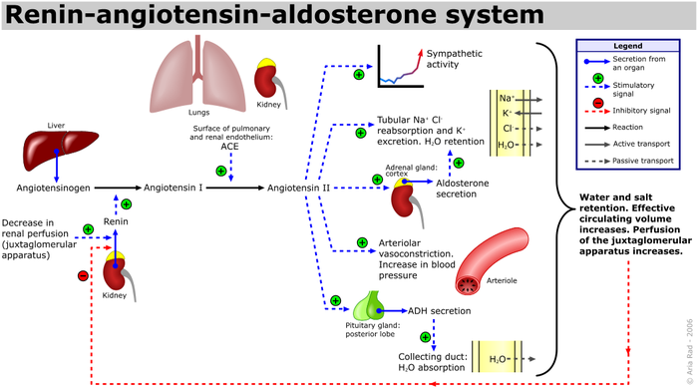
The renin angiotensin aldosterone system increases water and salt retention
A. Rad (me), CC BY-SA 3.0 <http://creativecommons.org/licenses/by-sa/3.0/>, via Wikimedia Commons

Slide 20
There is no clinical use for Beta 2 antagonists in humans
Why?
Recall the location of the receptors:
  Lung
  Mast cells
  Skeletal muscle
  (These would constrict the bronchioles and make mast cells more sensitive, so there is no clinical application for this type of drug)

Slide 21
References
Goldsy RA et Al. Immunology 5th ed. WH Freeman Publishers, 2003
Marieb E. Human Anatomy and Physiology, 5th ed. Benjamin Cummings, San Francisco, 2001
Rad, CC BY-SA 3.0 <http://creativecommons.org/licenses/by-sa/3.0/>, via Wikimedia Commons
Martini FH, et al. Visual Anatomy and Physiology 1st ed. Benjamin Cummings, 2011
Royalty free images from Shutterstock
The PowerPoint and associated Video were edited and produced by Dr. Ken Wojcikowski

